Slide 1


Slide 2
SUMMARY
SECTION 1:
Description of the given problem
The identification of the actors
Our goals
SECTION 2:
Overall Description
SECTION 3:
External interface requirements
Functional requirements
The World and the Machine
Scenarios
UML Models
SECTION 4:
Alloy

Slide 3
SECTION 1
DESCRIPTION OF THE GIVEN PROBLEM
We will design and implement myTaxiService, a new web and mobile application to optimize the taxi service in big cities. It should simplify the access of passengers to the service and guarantee a fair management of taxi queues. The users will have to register and login in order to use the application, then they can request a taxi and be informed about the code of the incoming taxi and the waiting time.
We suppose the city is divided in zones and every one of them has a queue of available taxis present in the zone, whose position is calculated according to GPS. After a request arrives, the system informs the first taxi in the queue of
the zone from which the request came. If the taxi accept the request, the system sends the confirmation to the user. If not, the system will put it at the end of the queue and forward the request to the next available taxi. To accept ride requests, taxi drivers will have to login through the mobile app like normal users. Then they can set themselves as available and receive ride requests. A user can also reserve a taxi by inserting origin, destination and time of the ride. The request must be submitted at least two hours before. The system will allocate a taxi and notify the user 10 minutes before the ride.

Slide 4
SECTION 1
ACTORS:
Guest: the guests are users who are not registered yet. They must sign themselves up into the system in order to use the features available to registered users.
Registered user: this type of user, after successful login, has access to all the features of the application as a customer. They can request rides, be them simple or detailed, and receive notifications after a ride has been confirmed.
Driver: this type of user, after a successful login, can set himself as available and so can be notified when a new ride request arrives and, if he sees it, to accepts it.

Slide 5
SECTION 1
OUR GOALS:
We have divided the goals for every categories of actors we have identified.
Guests should be able to:
[G1] Register themselves into the system
[G2] Log themselves into the system
Users should be able to:
[G3] See number of available taxis of the zone they’re in
[G4] Make a request for a simple ride
[G5] Make a request for a detailed ride

Slide 6
SECTION 1
OUR GOALS:
Drivers should be able to:
[G6] Set themselves as available
[G7] Read and accept ride requests
The system should:
[G8] Notify passengers after the confirmation of a simple request
[G9] Notify passenger ten minutes before the ride reserved through a detailed
request
[G10] Forward request to the first taxi in queue
[G11] After 30 seconds, forward the request to the second taxi in queue and put
the first at the end

Slide 7
SECTION 2
OVERALL DESCRIPTION:
Product perspettive:
The application we will project is both a web application and a mobile application. It will not interact with any other existing application or system. It will be user based and we will not provide any internal interface for administration.
User characteristics:
People that will use our application are the ones interested in using the taxi service in the city. They will be able to request a taxi for a ride without any voice call but just with few clicks.

Slide 8
SECTION 2
OVERALL DESCRIPTION:
Assumptions:
When the app or the web page is closed the user automatically logs out.
If a driver sees a ride request, he always accepts it.
Users can't cancel ride requests.
If the system sends a notification the user will always receive it.
Users can make an unlimited number of daily ride requests.
In case of empty queue 10 minutes before a detailed ride, the application will always manage to find one within the time of the ride.
Users insert existing addresses when making requests.
The system knows if the credentials inserted during login belong to a user or a driver, so it will display the correct personal page afterwards.

Slide 9
SECTION 3
EXTERNAL INTERFACE REQUIREMENTS
User interfaces:
Here are presented some drafts which represent how the application should look like. We decided to represent only the mobile application but the web one will be the same.
Login page
This is the page that shows up when the application is started. It allows the guests to log themselves into the system or register themselves if they don't have an account yet.
2) User page
After login, this is what users will see. The graphic is minimal but really user friendly, so that users can easily access to all of their functions.
Driver page
After login, this is the page drivers will see. It allows them to set themselves as available and start receiving requests and access to the page where the requests are.

Slide 10
SECTION 3
EXTERNAL INTERFACE REQUIREMENTS
1
2
3

Slide 11
SECTION 3
FUNCTIONAL REQUIREMENTS
[G1] Register themselves into the system
[R1] Guests can only see the login page.
[R2] Guests can only access to the registration form.
[D1] All the fields must be completed in a formal correct way.
[G2] Log into the system
[R1] Guests have to provide valid username a password in order to log themselves into the system.
[R2] The wrong insertion of one's own credentials will not allow to log himself into the system.
[G3] See number of available taxis of the zone he's in
[R1] The system has to visualize on the personal page the number of taxi available in the zone.

Slide 12
SECTION 3
FUNCTIONAL REQUIREMENTS
[G4] Make a request for a simple ride
[R1] Users have to insert the correct departure's address.
[D1] The inserted address has to be formed by a street and a civic number.
[G5] Make a request for a detailed ride
[R1] Users have to insert the correct departure's address.
[R2] Users have to insert the correct destination's address.
[R3] Users have to insert feasible date and time for the reservation.
[D1] The inserted address has to be formed by a street and a civic number.
[D2] Date must look like this: DD/MM/YY, and time like this: HH:MM.
[G6] Set themselves as available
[R1] The system has to provide a function through which drivers can inform it of their availability.
[R2] Once they're available, the system has to insert them into the Taxi Queue of their own zone.

Slide 13
SECTION 3
FUNCTIONAL REQUIREMENTS
[G7] Read and accept ride requests
[R1] The system has to provide a function to read and accept request
[G8] Notify passengers after the confirmation of a simple request
[R1] The system has to notify the user who made a simple request as soon as possible, this means as a taxi is available, informing him about the waiting time.
[G9] Notify passengers 10 minutes before the ride reserved through a detailed request
[R1] The system has to notify the user who reserved a taxi within ten minutes before the time of the ride.

Slide 14
SECTION 3
FUNCTIONAL REQUIREMENTS
[G10] Forward requests to the first taxi in queue
[R1] The system has to forward requests to the first taxi in queue allowing him to accept the request.
[R2] After a confirmation by a driver the system has to move the driver at the end of the queue and set him as not available.
[G11] After 30 seconds, forward the request to the second taxi in queue and put the first at the end
[R1] After a missed confirmation the system has to move the first driver in queue to the last position and forward the request to the second until one driver confirm the request.

Slide 15
SECTION 3
THE WORLD AND THE MACHINE

Slide 16
SECTION 3
SCENARIOS:
Scenario 1
Bob has planned to go to a workshop that will take place on the other side of Milan. He woke up early because he knows that there's always so much traffic in the city. Bob is ready to go with his car when the unexpected happens: the car seems broken. Without wasting any time he opens myTaxi app on his phone. He logs into the system and request a Taxi for a simple ride. John, already logged into the system as driver, sees the simple request on his phone and accepts it. The system immediately notifies Bob telling him John's taxi code and the relative waiting time. Bob has to attend just a few minutes because John's Taxi is only one kilometre away from him. Bob is happy because he will arrive on time despite the unexpected discovery of having his car broken.

Slide 17
SECTION 3
SCENARIOS:
Scenario 2
Bob, during the lunch break at the workshop, realizes that at the end of the event he doesn't have his car because he arrived in taxi. He also realizes that the end of the workshop is scheduled at 6p.m, critical time for traffic in the city with several waiting time for taxis. In order to this consideration, Bob opens myTaxi app and reserves a taxi for 6.15 p.m. to be sure that a taxi will be there at that moment. At 6.05 p.m. Bob's phone rings. A notification with the code of taxi that will arrive to him has just been received from his phone.

Slide 18
SECTION 3
SCENARIOS:
Scenario 3
It's 12a.m. and John, a taxi driver, decides to have a coffee break but he also decides to not log out from the app because he is the third in the Taxi Queue. He thinks he can drink a coffee and smoke a cigarette before he becomes the first of the Taxi Queue. . . but he is wrong. The other two driver that were in list before him log out from the system and John becomes the first in the Taxi Queue. A request arrives but Bob doesn't see it because he is still drinking his coffee. After 30 seconds John hasn't accepted yet and the system puts him into the last position forwarding the request to the second in list.

Slide 19
SECTION 3
SCENARIOS:
Scenario 4
Giuly decides to go to EXPO in the evening. She knows that the queue to enter is very long so she decides to go there at 5 pm in order to be in a good position when the gate will open. Giuly is scared to take the train to go there because she would be going back home alone. She decides to go there with a taxi and simply she opens myTaxi app and requests a taxi for a simple ride. Unfortunately, the system has detected that there is no one taxi available in her zone at the moment. Giuly immediately receives a notification that informs it of the problem inviting her to attend for the first available taxi.

Slide 20
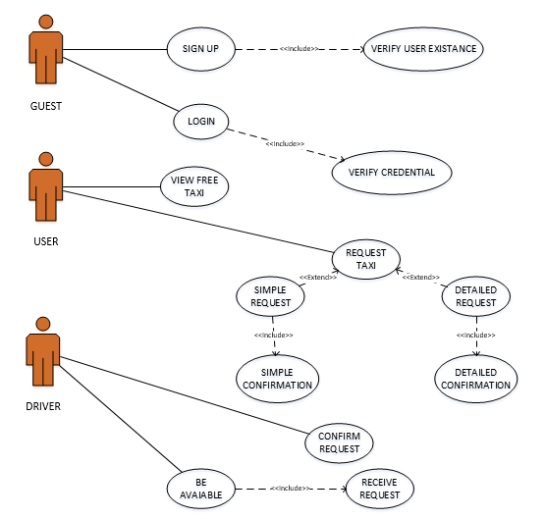
SECTION 3 – UML MODELS
USE CASE:

Slide 21
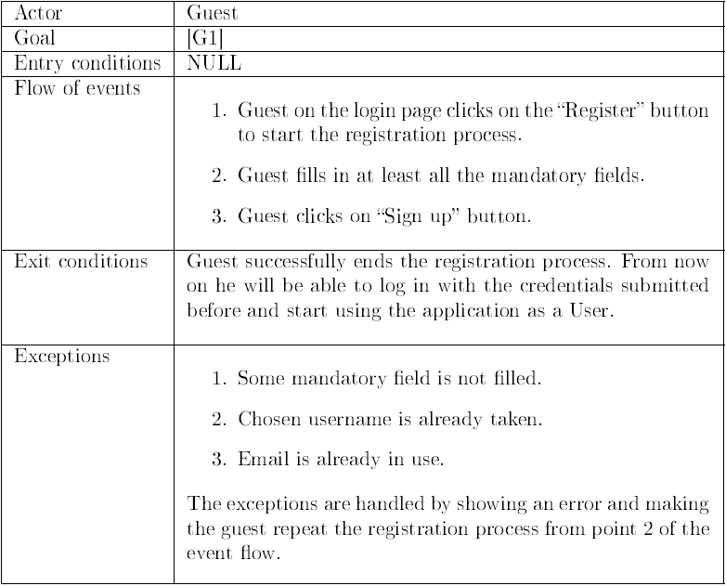
SECTION 3 – UML MODELS
SIGN UP:

Slide 22
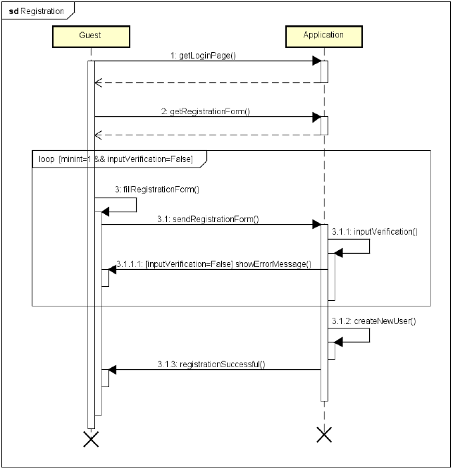
SECTION 3 – UML MODELS
SIGN UP:

Slide 23
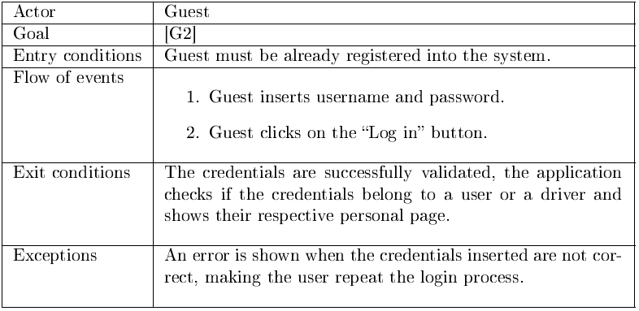
SECTION 3 – UML MODELS
LOG IN:

Slide 24
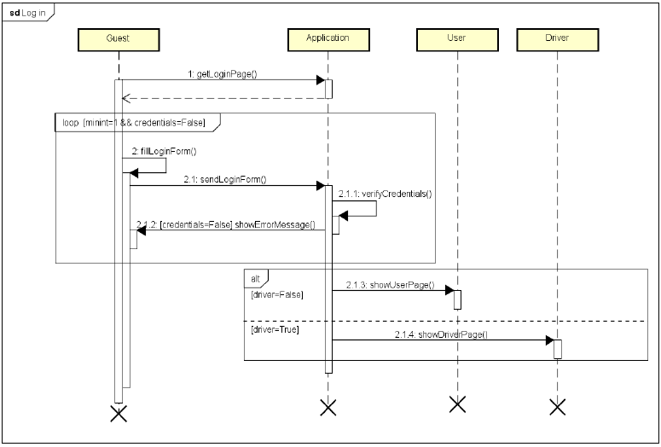
SECTION 3 – UML MODELS
LOG IN:

Slide 25
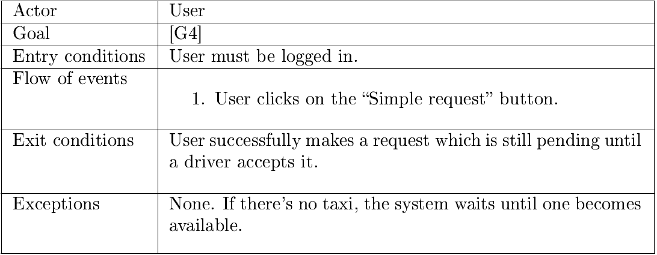
SECTION 3 – UML MODELS
MAKE SIMPLE REQUEST:

Slide 26
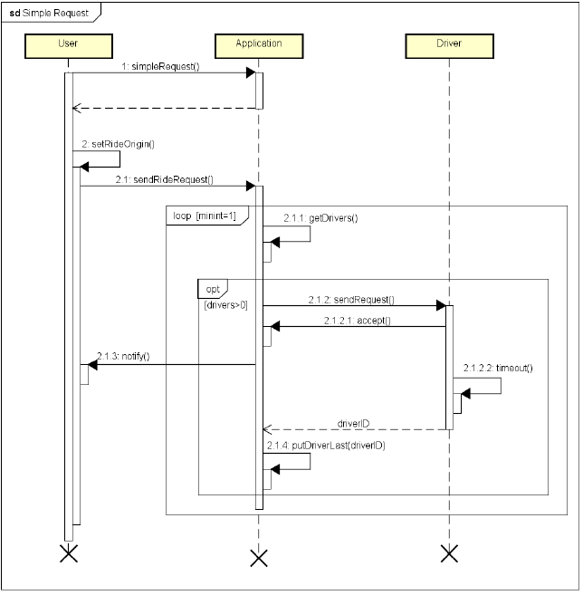
SECTION 3 – UML MODELS
MAKE SIMPLE REQUEST:

Slide 27
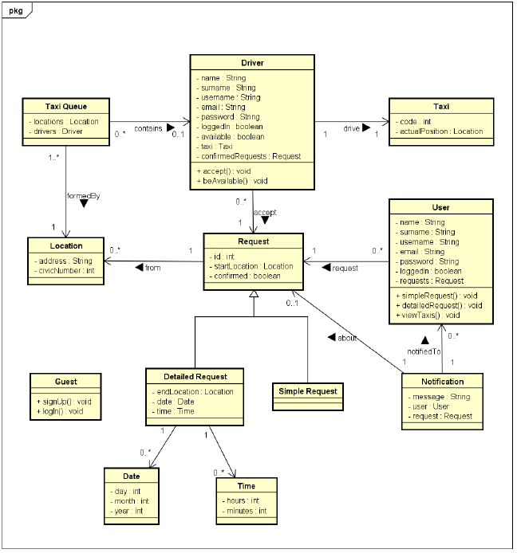
SECTION 3
UML MODELS
CLASS DIAGRAM:

Slide 28
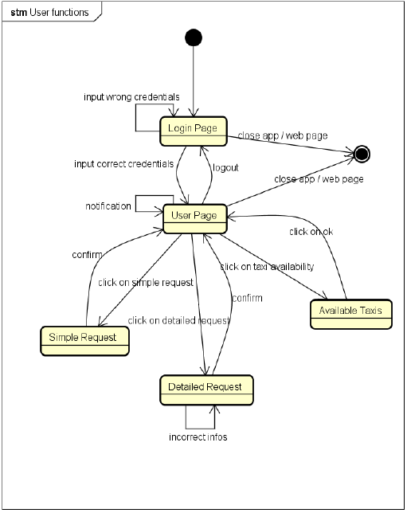
SECTION 3
UML MODELS
STATE MACHINE DIAGRAM
USER FUNCTIONS:

Slide 29
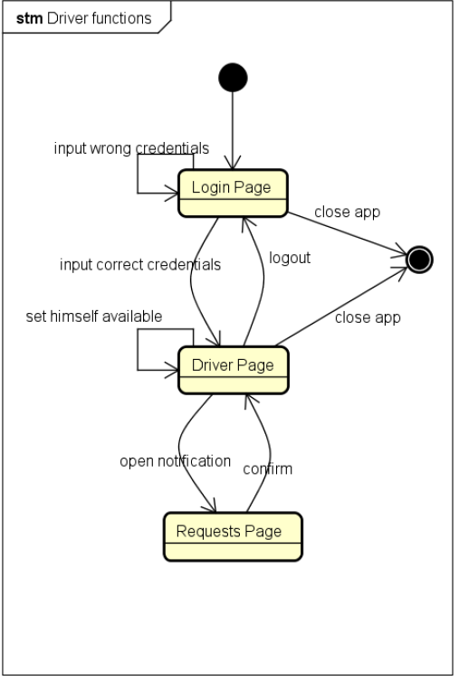
SECTION 3
UML MODELS
STATE MACHINE DIAGRAM
DRIVER FUNCTIONS:

Slide 30
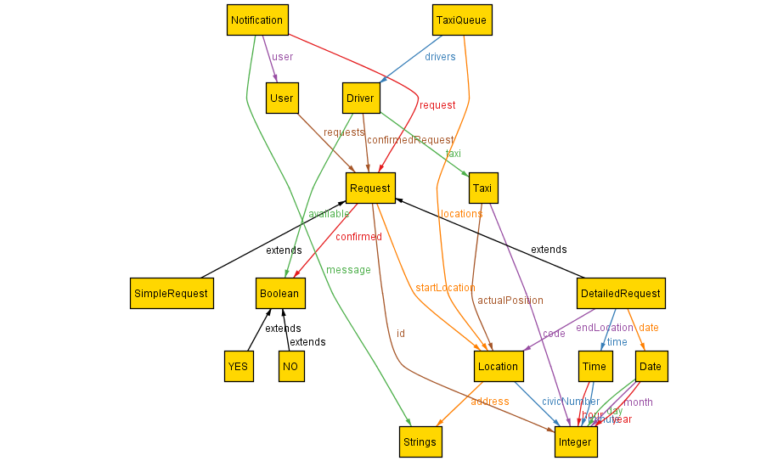
SECTION 4
ALLOY METAMODEL:

Slide 31
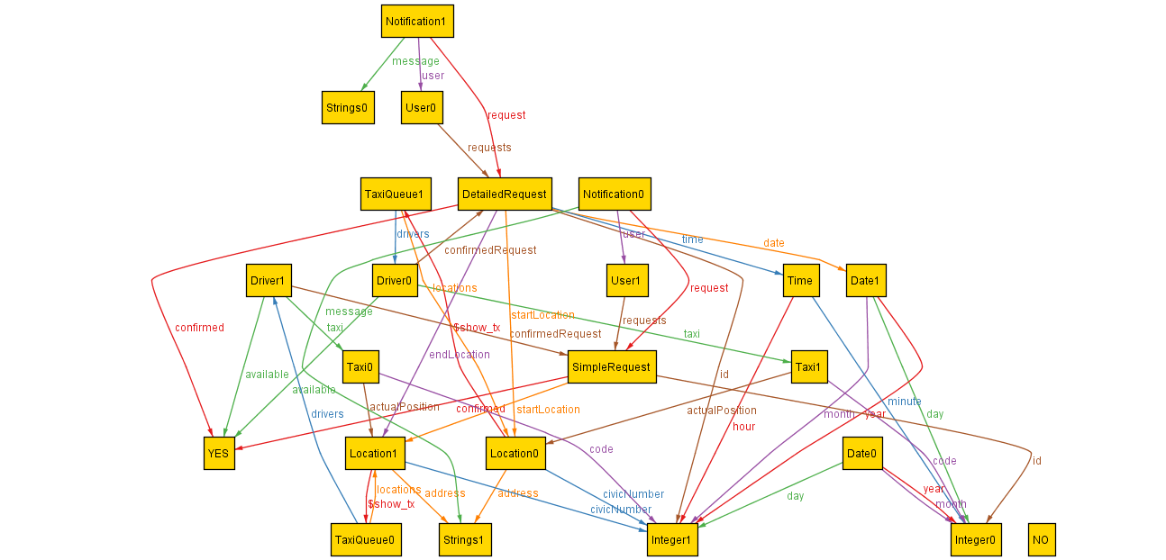
SECTION 4
EXAMPLE OF GENERATED WORLD:

